Slide 1
RSM222
Management Accounting 1
Class 9:Planning and Control: Standard Cost & Variance Analysis
Elisa Zuliani

Slide 2
Learning Objectives
Describe standard costs.
Compute direct materials price and quantity variances.
Compute direct labor rate and efficiency variances.
Compute variable manufacturing overhead spending and efficiency variances.
Compute and interpret the fixed overhead budget and volume variances.

Slide 3
Standard Costs
Standards are benchmarks or “norms” for measuring performance. Two types of standards are commonly used:
Quantity standards specify how much of an input should be used to make a product or provide a service.
Cost (price) standards specify how much should be paid for each unit
of the input.
How much of an input should be used in the production of X
How much should be paid for each unit of input.

Slide 4
Standards vs. Budgets
Both standards and budgets are predetermined costs, and both contribute to management planning and control.
  There is a difference:
    A standard is a unit amount.
    A standard is a per unit cost
    A budget is a total amount.
A standard can be viewed as the budgeted cost for one unit of product

Slide 5
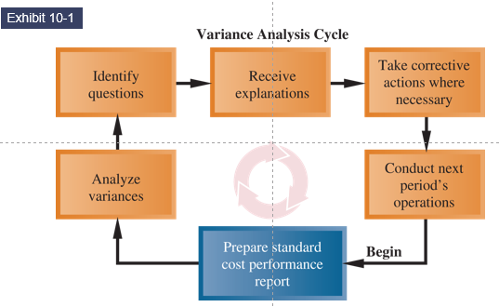
Variance Analysis Cycle

Slide 6
Setting Standard Costs
Setting standard costs requires input from all persons who have responsibility for costs and quantities.
Standards should change whenever managers determine that the existing standard is not a good measure of performance.
Allow for no machine breakdowns or other work interruptions
require peak efficiency all the time.
IDEAL STANDARDS
Allow for normal machine downtime and other work interruptions
can be attained through reasonable efforts by the average employee.
PRACTICAL STANDARDS
When would each be relevant?

Slide 7
Setting Direct Material Standards
Standard Price
per Unit
Standard Quantity
per Unit
Final, delivered cost of materials, net of discounts including
shipping, receiving, and other such costs.
The amount of material required for each unit,
as well as an allowance for unavoidable waste, spoilage, and other normal inefficiencies.

Slide 8
Setting Direct Labour Standards
Standard Rate
per Hour
Standard Hours
per Unit
The labour rate that should be incurred per hour of labour time, including Employment Insurance, employee benefits, and other labour costs.
Use time and
motion studies for each labour operation to
determine the amount of labour
time to complete one unit.
Should include allowance for normal inefficiencies.

Slide 9
Setting Variable Overhead Standards
Price Standards
Quantity Standards
The rate is the variable portion of the
predetermined overhead
rate.
The quantity is the
activity in the allocation base used to calculate the predetermined overhead.
For manufacturing overhead, companies use a standard predetermined overhead
rate in setting the standard.
Overhead rate is determined by dividing budgeted overhead costs by an expected standard activity index, such as standard direct labor hours or standard machine hours.

Slide 10
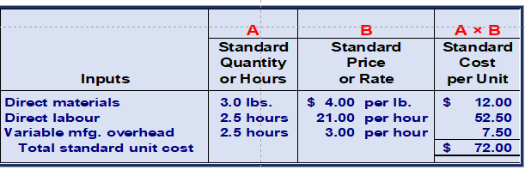
Standard Cost - Production
A standard cost for one unit:

Slide 11
Variance Analysis
Variance is defined as:
Variance = Actual - Budget
It is the difference between standard and actual prices or standard and actual quantities
  Actual costs < Standard costs = Favorable Variance.
  Actual costs > Standard costs = Unfavorable Variance.
A variance can result from differences related to the cost of materials, labor, or overhead.

Slide 12
Why do we Care?
How does this relate to last class?
Formulating long and short-term plans (Planning)
Variances provide warning signs of situations requiring corrective action by managers.
This process of focusing on variances is also known as “management by exception.”
  Issues are brought to the attention of management if results represent substantial differences from the budget
Comparing actual to planned performance (Controlling)
Implementing plans (Directing and Motivating)
Decision
Making
Measuring performance (Controlling)

Slide 13
Why do we Care? (cont’d)
Monitoring + Continuous Improvement
Variances need to be reviewed regularly by management and corrective actions should be taken for unfavorable variances.
Can be used to evaluate performance of employees as long as the worker has control/responsibility over the variance being analyzed.
Performance Evaluation

Slide 14
Variance Analysis
Price Variance
Quantity Variance
Difference between actual price and standard price
Difference between actual quantity and standard quantity

Slide 15
Variance Analysis
Price Variance
Quantity Variance
Material price variance
Labour rate variance
VOH spending variance
Material quantity variance
Labour efficiency variance
VOH efficiency variance

Slide 16
Model for Flexible Variance Analysis
Actual
Results
Flexible Budget
Master Budget
Actual Quantity
×
Actual Price
Actual Quantity
×
Standard Price
Standard Quantity
×
Standard Price
Price Variance
Quantity Variance
A variance could be to a change in quantity or a change in price
Total Flexible Budget Variance
(AQ × AP) – (AQ × SP)
AQ = Actual Quantity AP = Actual Price
(AQ × SP) – (SQ × SP)
SP = Standard Price
SQ = Standard Quantity

Slide 17
Model for Flexible Variance Analysis
Actual quantity is the amount of direct material, direct labour, and variable manufacturing overhead actually acquired price
Actual Quantity
×
Actual Price
Actual Quantity
×
Standard Price
Standard Quantity
×
Standard Price
Price Variance
Quantity Variance
Total Flexible Budget Variance

Slide 18
Model for Flexible Variance Analysis
Standard quantity is the amount of direct material, direct labour, and variable manufacturing overhead actually acquired price
Actual Quantity
×
Actual Price
Actual Quantity
×
Standard Price
Standard Quantity
×
Standard Price
Price Variance
Quantity Variance
Total Flexible Budget Variance

Slide 19
Model for Flexible Variance Analysis
Actual price is the amount actually paid for amount of the input acquired
Actual Quantity
×
Actual Price
Actual Quantity
×
Standard Price
Standard Quantity
×
Standard Price
Price Variance
Quantity Variance
Total Flexible Budget Variance

Slide 20
Model for Flexible Variance Analysis
Standard price is the amount that should have been paid for the amount of input used
Actual Quantity
×
Actual Price
Actual Quantity
×
Standard Price
Standard Quantity
×
Standard Price
Price Variance
Quantity Variance
Total Flexible Budget Variance

Slide 21
Model for Flexible Variance Analysis
Actual
Results
Flexible Budget
Master Budget
Actual Quantity
×
Actual Price
Actual Quantity
×
Standard Price
Standard Quantity
×
Standard Price
Price Variance
Quantity Variance
Total Flexible Budget Variance
(AQ × AP) – (AQ × SP)
AQ = Actual Quantity AP = Actual Price
(AQ × SP) – (SQ × SP)
SP = Standard Price
SQ = Standard Quantity

Slide 22

Flexible Budget Variances
Price Variance
AQ * (AP-SP)
A = Actual
Q = Quantity P = Price
S = Standard (Budgeted / Standard)
Quantity Variance
SP * (AQ-SQ)
15

Slide 23


Material Variance - Example
Glacier Peak Outfitters has the following direct material standard for the fibrefill in its mountain parkas.
0.1 kg. of fibrefill per parka(p) at $5.00 per kg.
Last month 210 kgs of fibrefill were purchased and used to make 2,000 parkas. The material cost a total of $1,029.
Actual Quantity
×
Actual Price
210 kgs
X
$4.90/kg
= $1,029
Actual Quantity
×
Standard Price
210 kgs
X
$5.00 / kg
= $1,050
Standard Quantity
×
Standard Price
200 kgs
X
$5.00 / kg
= $1,000
Price Variance
$21 favourable
Quantity Variance
$50 unfavourable
$29 unfavourable

Slide 24
Material Variance – Using the Equations
Materials price variance:
  MPV = AQ (AP – SP)
  = 210 kgs ($4.90/kg – $5.00/kg)
  = 210 kgs (-$0.10/kg)
  = $21 F
Materials quantity variance:
  MQV = SP (AQ – SQ)
  = $5.00/kg (210 kgs – (0.1 kg/p × 2,000p))
  = $5.00/kg (210 kgs – 200 kgs)
  = $5.00/kg (10 kgs)
  = $50 U

Slide 25
Labour Variance - Example
Glacier Peak Outfitters has the following direct labour standard for its mountain parka.
0.6 standard hours per parka at $20.00 per hour
Last month, employees actually worked 1,250 hours at a total labour cost of $26,250 to make 2,000 parkas.
Actual Hours
×
Actual Price
1,250 hours
x
$21/hour
= $26,250
Actual Hours
×
Standard Price
1,250 hours
X
$20/ hour
= $25,000
Standard Hours
×
Standard Price
1,200 hours
X
$20 / hour
= $24,000
$26,250 ÷ 1,250 hours = $21.00 per hour
0.6 hours per parks x 2,000 parkas = 1,200 hours
Rate Variance
$1,250 unfavourable
Efficiency Variance
$1,000 unfavourable
$2,250 unfavourable

Slide 26
Labour Variance – Using the Equations
Labour rate variance
  LRV = AH (AR – SR)
  = 1,250 hours ($21.00/hour – $20.00/hour)
  = 1,250 hours ($1.00/hour)
  = $1,250 unfavourable
Labour efficiency variance
  LEV = SR (AH – SH)
  = $20.00/hr (1,250 hours – 1,200 hours)
  = $20.00/hr (50 hours)
  = $1,000 unfavourable

Slide 27
Variable Overhead Variance - Example
Glacier Peak Outfitters has the following direct variable manufacturing overhead labour standard for its mountain parka.
0.6 standard hours per parka at $8.00 per hour
Last month, employees actually worked1,250 hours to make 2,000 parkas. Actual variable manufacturing overhead for te month was $10,500
Actual Hours
×
Actual Price
1,250 hours
x
$8.40/hour
= $10,500
Actual Hours
×
Standard Price
1,250 hours
X
$8/ hour
= $10,000
Standard Hours
×
Standard Price
1,200 hours
X
$8 / hour
= $9,600
0.6 hours per parks x 2,000 parkas = 1,200 hours
$10,500 ÷ 1,250 hours = $8.40 per hour
Spending Variance
$500 unfavourable
Efficiency Variance
$400 unfavourable
$900 unfavourable

Slide 28
Variable Manufacturing Overhead Variance – Using the Equations
Variable manufacturing overhead spending variance
  VMSV = AH (AR – SR)
  = 1,250 hours ($8.40/hour – $8.00/hour)
  = 1,250 hours ($0.40/hour)
  = $500 unfavourable
Variable manufacturing overhead efficiency variance
  VMEV = SR (AH – SH)
  = $8.00 per hour (1,250 hours – 1,200 hours)
  = $8.00 per hour (50 hours)
  = $400 unfavourable

Slide 29
Standard Costs and Variances in the Service Industry
Standard costing can help service business to better understand and manage their costs
The main difference is the terminology used and the lack of cost of goods sold

Slide 30
Fixed Overhead Variance
To understand fixed overhead variances, it is necessary to first understand how overhead is applied to WIP in a standard costing system.
In a normal cost system, overhead is applied to work in process based on the actual number of hours worked in the period.
In a standard cost system, overhead is applied to work in process based on the standard hours allowed for the actual output of the period.

Slide 31
Overhead Application in a Standard Costing System
Notice the difference from what we have previously seen.
In a normal cost system, overhead is applied to work in process based on the actual number of hours worked in the period.
In a standard cost system, overhead is applied to work in process based on the standard hours allowed for the actual output of the period.
Normal Costing MOH (T-Account)
Actual OH | Applied OH (Actual Hours * POHR)
Standard Costing MOH (T-Account)
Actual OH | Applied OH (Standard Hours * POHR)

Slide 32
Fixed Overhead Variance
Actual Fixed Overhead Incurred
Fixed Overhead Budget
DH x FR
Fixed Overhead Applied
SH x FR
Budget variance
- Measure of the difference between the actual Fixed overhead incurred during the period and the budgeted fixed overhead costs as stated in the flexible budget
Volume Variance
- Measure of utilization of plant facilities
DH = Denominator Hours
FR = Standard Fixed Overhead Rate
SH = Standard Hours Allowed

Slide 33
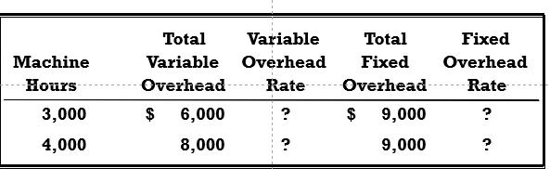
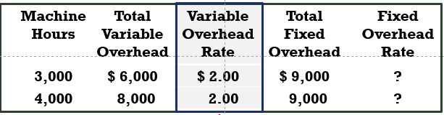
Overhead Rates and Overhead Analysis - Example
Rate = Total Variable Overhead / Machine Hours

Slide 34
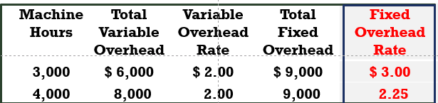
Overhead Rates and Overhead Analysis - Example
Rate = Total Fixed Overhead / Machine Hours
The total POHR is the sum of
the fixed and variable rates
for a given activity level.

Slide 35
Fixed Overhead Variance - Example
- ColaCo’s actual production required 3,200 standard machine hours
- Actual fixed overhead was $8,450
- The predetermined overhead rate is based on 3,000 machine hours
Fixed Overhead Applied
SH x FR
3,200 hours
X
$3.00 / hour
= $9,600
Actual Fixed Overhead Incurred
$8,450
Fixed Overhead Budget
$9,000
Budget variance
$550 favourable
Volume Variance
$600 favourable
$1,150 favourable

Slide 36
Why do Variances Occur?
Direct Materials Variances | Direct Labour Variances
Change in quality of material Change in quantity purchased (volume discount) New supplier Better negotiation Drop / increase in price of material | A new union contract Change in average experience or training of workers Change in government regulations Unanticipated overtime
Normal fluctuations in usage Change in production process Change in proportion of spoilage Change in quality of materials Change in equipment & technology Equipment malfunction Theft of material | Change in equipment or technology Change in training and experience of workers Improved performance from training programs Change in employee turnover Intentional or unintentional reporting of labour hours. Unreasonable labour hours standard
PRICE
QUANTITY

Slide 37
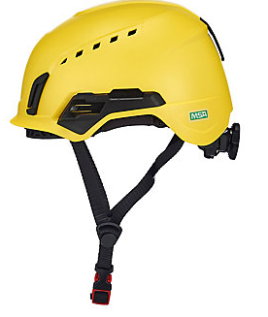
IN CLASS EXAMPLE
Emerson Sport

Slide 38
Any Questions?

